Slide 1
Hadoop distributed file system (HDFS)

Slide 2
Hadoop Internals

Slide 3
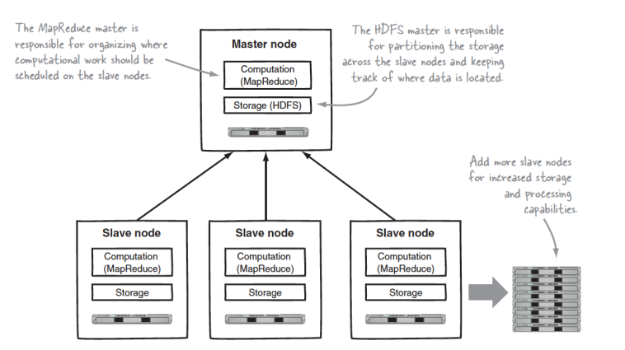
How does Hadoop Work?
Uses master slave architecture
The master node is the coordinator
Schedules MapReduce Jobs
In charge of where the data is spread across the slave nodes.
Two main layers of software
MapReduce Computation Layer
Distributed File System HDFS

Slide 4
Goals of Hadoop Distributed File System HDFS
Very Large Distributed File System
– 10,000 nodes, 100 million files, 10 PB
Assumes Commodity Hardware
– Files are replicated to handle hardware failure
– Detect failures and recovers from them automatically
Optimized for Batch Processing
– Move computation to data
– Provides very high aggregate bandwidth

Slide 5
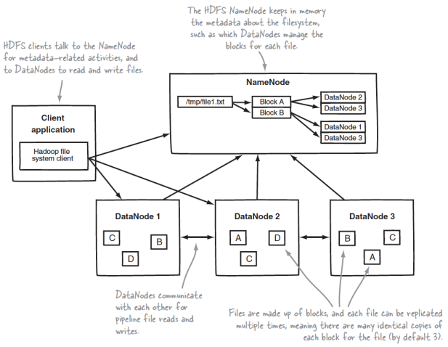
HDFS: DataNodes / NameNode
Data split into fixed sized blocks (typically 128 MB)
By default each block is replicated across 3 data nodes (example above shows replication across 2 data nodes)
Master slave architecture
MasterNode: NameNode
SlaveNodes : DataNodes

Slide 6
HDFS: DataNodes / NameNode
NameNode
Stores the meta data
Meta data contains the location of where the different data blocks reside.
DataNodes
Stores the actual data blocks.
Client application first communicates with the NameNode to find where the data resides and then directly contacts the DataNodes to get the required data.

Slide 7
Hadoop Distributed File System HDFS
Single Namespace for entire cluster
Data Coherency
– Write-once-read-many access model
– Client can only append to existing files
Files are broken up into blocks
– Typically 128 MB block size
– Each block replicated on multiple DataNodes

Slide 8
NameNode Metadata
Meta-data in Memory
– The entire metadata is in main memory
– No demand paging of meta-data
Scalability of HDFS determined by memory size of NameNode
Usually put NameNode on a bigger more powerful server with more memory than DataNodes
Types of Metadata
– List of files
– List of Blocks for each file
– List of DataNodes for each block
– File attributes, e.g creation time, replication factor

Slide 9
DataNode
A Block Server
Stores data in the local file system (e.g. ext4)
Stores meta-data of a block (e.g. CRC)
Serves data and meta-data to Clients
Block Report
Periodically sends a report of all existing blocks to the NameNode
If no block report received by NameNode within certain time frame (say 30 minutes) then assume DataNode down
Replicate all blocks of the failed DataNode to other DataNodes
Facilitates Pipelining of Data
Forwards data to other specified DataNodes
Next slide shows what happens when data is written into HDFS

Slide 10
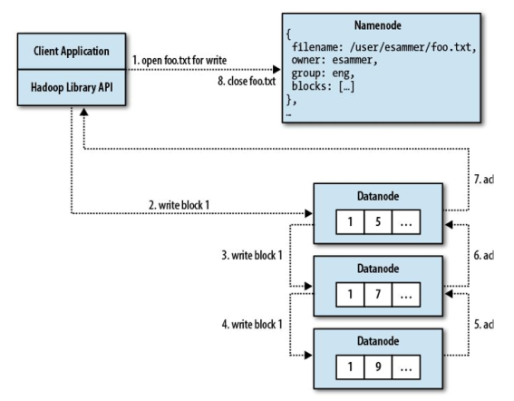
Write Path in HDFS
Example of writing a new file.
Client first sends write request to NameNode
NameNode tells client which DataNodes to write the first block into.
Client send first block to the first DataNode
Written into the local filesystem of the first DataNode
The first DataNode copies the block to the second DataNode (pipeline)
The second DataNode copies the block to the third DataNode (pipeline)
Then acknowledgements of successful write is propagated back to the client
The above is repeated for the 2nd block.
The NameNode is again contacted to determine where to write the 2nd block
The above approach minimizes the amount of contact needed to the Namenode.
More scalable.

Slide 11
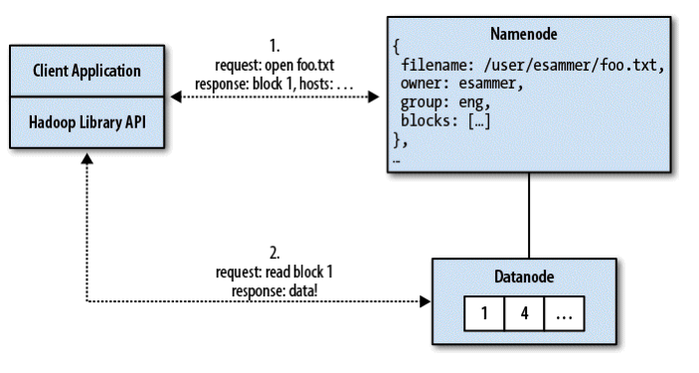
Read Path in HDFS
Client requests a file to read
NameNode tells the client the location of the three replicas of the first block of the file.
The locations are sorted in terms of distance to the client incorporating rack topology knowledge
Client then gets the block from the nearest node.
Client will try to get from a different node if block returned is corrupt due to checksum not matching.

Slide 12
HDFS blocks and local storage
The HDFS logical blocks are actually stored as files in the local file system
For example a file is divided into two blocks A and B.
A file will be created inside the local file system of each data node to store block A. The same for block B.

Slide 13
Small Files
If a file is 100 bytes in size, it will occupy one HDFS block.
However, the block will be stored in a 100 byte file in the local file system of the Datanodes.
Therefore there is no waste of space.
However, having a lot of small files is bad since the Namenode need to keep track of it all.
The total meta data size of many small files maybe too big to fit in the RAM of the Namenode.

Slide 14
Data Correctness
Use Checksums to validate data
– Use CRC32
File Creation
– Client computes checksum per 512 byte
– DataNode stores the checksum
File access
– Client retrieves the data and checksum from DataNode
– If Validation fails, Client tries other replicas

Slide 15
Rebalancer
Goal: % disk full on DataNodes should be similar
Moves blocks around to balance number of blocks per DataNode
Computational parallelism also depends on where the data resides
Usually run when new DataNodes are added
Rebalancer is throttled to avoid network congestion
Command line tool

Slide 16
NameNode Failure
A single point of failure
All meta data (where data blocks reside, etc.) kept in RAM.
What happens when the NameNode dies?
All the contents in DataNodes are no longer accessible. We do not know where any of the data resides.
The edits log
A log of all the changes that have occurred to the meta data
E.g. the deletion of blocks, insertion of blocks, etc.
fsimage
Contains the latest snapshot of the meta data.
During recovery
Load fsimage and then replay edit logs to get up-to-date.

Slide 17
Secondary NameNodes
The old snapshot (fsimage) may become too old.
edits log also gets too large
If recovery is needed then it will take a long time to reply all the edits.
The idea is to create a new fsimage by playing back the edits.
This is very computationally expensive
Use a different node to do this in the background
Secondary NameNode
Usually on a different machine from the NameNode itself.

Slide 18
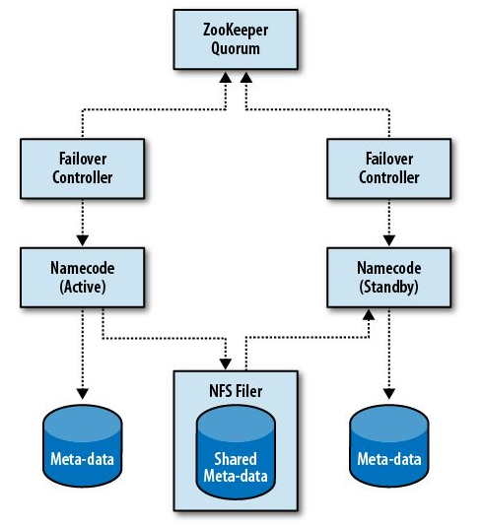
NameNode High Availability
During failure recovery replying edits takes a long time
Results in long down time for entire Hadoop cluster.
Have a standby NameNode
Standby NameNode constantly replaying the edits log to keep an almost-up-to-date in RAM image of the active NameNode meta data.
The new edits are appended to an edits log which is stored over NFS
The standby NameNode gets the new edits from the log stored over NFS.
During failure the system will automatically failover to the standby Namenode.
No secondary node needed when we have a standby NameNode.
There can be only one active NameNode at one time.
ZooKeeper is a distributed consensus service which can be used to elect a single node as the active NameNode.

